Slide 1
COVID-19 Property Pandemic
The Avengers

Slide 2

The Team
Duane Conley
Johnathon Pinson
Shawn Ramrup
Nitu Singh
Angela Silveira
How we chose approached this project:
Multiple ideas identified
Reviewed data available for each idea - some were ruled out as not being viable options
Two datasets emerged as being robust & relevant – COVID-19 and home sales

Slide 3
Mission and Goals
The goal of this project is to create a machine learning model to predict housing prices. We also want to see how or if Covid-19 has affected housing prices. Our model uses the average house price per month from the years 2010-2019 to try and predict housing prices.
Did Covid-19 cause prices to go up or down?
Did the amount of cases in the area affect the prices?

Slide 4


Background & Overview
COVID-19 (SARS-CoV-2) is a novel coronavirus first reported in China in December 2019.
The first confirmed case in the United States was reported January 21, 2020.
WHO issues Global Health Emergency on January 31, 2020 & declares COVID-19 a pandemic on March 11, 2020.
Beginning in March, preventive measures in the US included stay-at-home orders and non-essential business restrictions.
Many larger urban cities experienced surging COVID-19 cases.
This analysis will look to determine how surges in COVID-19 cases in the US have impacted real estate sale price trends in/around urban cities in 2020.
Notes:
Research question: How have surges in COVID-19 cases in the US impacted real estate sale price trends in/around urban cities in 2020?

Slide 5
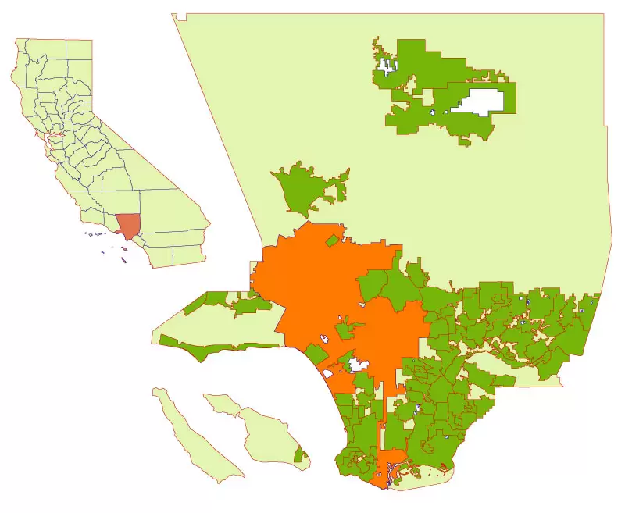
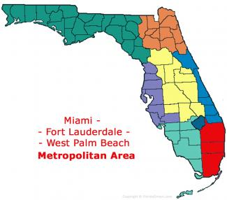
Background & Overview
Our sample was narrowed down to two metro areas, Miami FL and Los Angeles CA.

Slide 6
Background & Overview
Los Angeles Metro
Miami Metro
Population: 12,447,000 (2020)
33,954 sq miles
Second largest urban region in the US
Closest Ocean: Pacific
Population: 6,122,000 (2020)
6,137 sq miles
Seventh largest urban region in the US
Closest Ocean: Atlantic

Slide 7
Understanding the data
Real Estate
COVID-19
Zillow dataset
3,000+ datapoints
City/State
Sale Price
Month/Year
2018-2020
John Hopkins University dataset (available on Kaggle.com)
3,000+ datapoints
County/State
Daily confirmed cases
1/22/20-12/7/20

Slide 8
Tools
Pandas - ETL
Database(s) - SQL
Machine Learning
Linear Regression
Tableau - visualizations

Slide 9
Data Preparation
Selection
Transformation
Database
In-production services
Advanced projects

Slide 10
Machine Learning
Predictive Modeling – 2020 “should have been” vs. 2020 actual
In-production services
Advanced projects

Slide 11
Visualizations
2020 ML model vs. 2020 actual (box & whisker)
COVID-19 cases (heatmap) with real estate (heatmap)
4
4
5
35
25
22
15

Slide 12
Limitations
As we are currently still living thru this pandemic, our Covid-19 and housing data only go to 10/31/2020.
Our data did not include the number of homes sold.
We only had the resources to look at two areas.

Slide 13
Summary & Recommendations

Slide 14
Sources
https://www.macrotrends.net/
https://www.Zillow.com
https://www.Kaggle.com

